Slide 1
CS/COE 445 Data Structures
Lab 8 – Backtracking and Explicit Recursion
Stack
(Based on Dr. Hoot’s Lab Manual for Data Structures and Abstractions with Java ™)

Slide 2
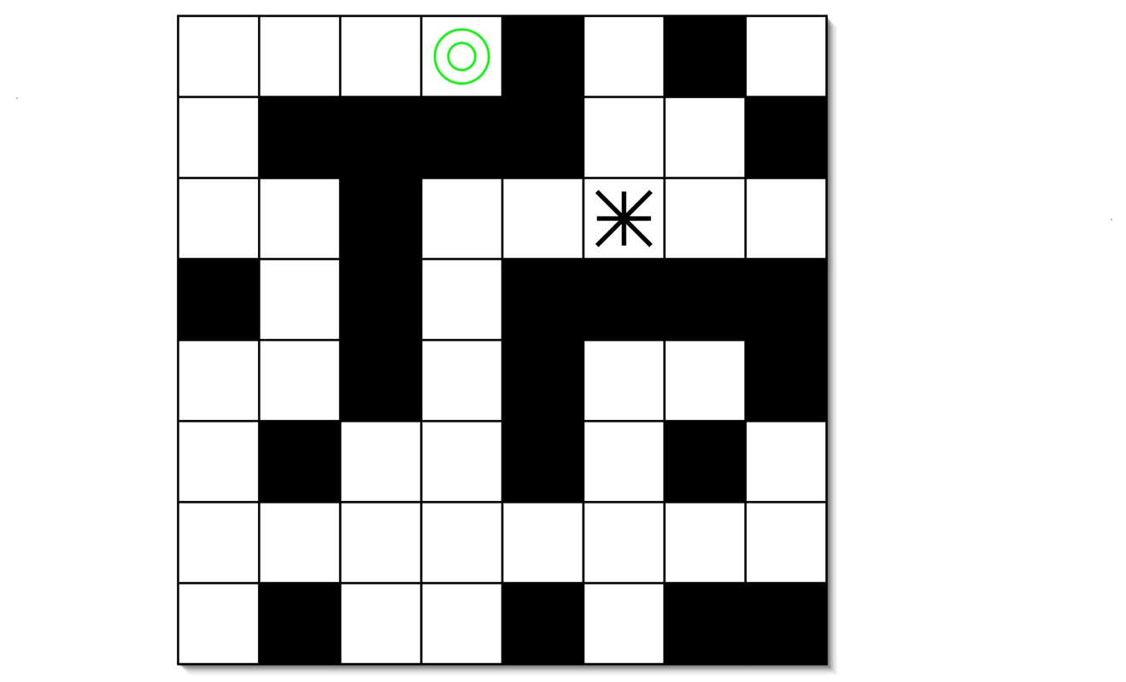
Maze
Robo-rat is placed in the maze.
A battery is placed in a different location in the maze.
Robo-rat needs to search to find the battery.
In the below picture, the starting location of Robo-rat is the star and the battery is the double circle.

Slide 3
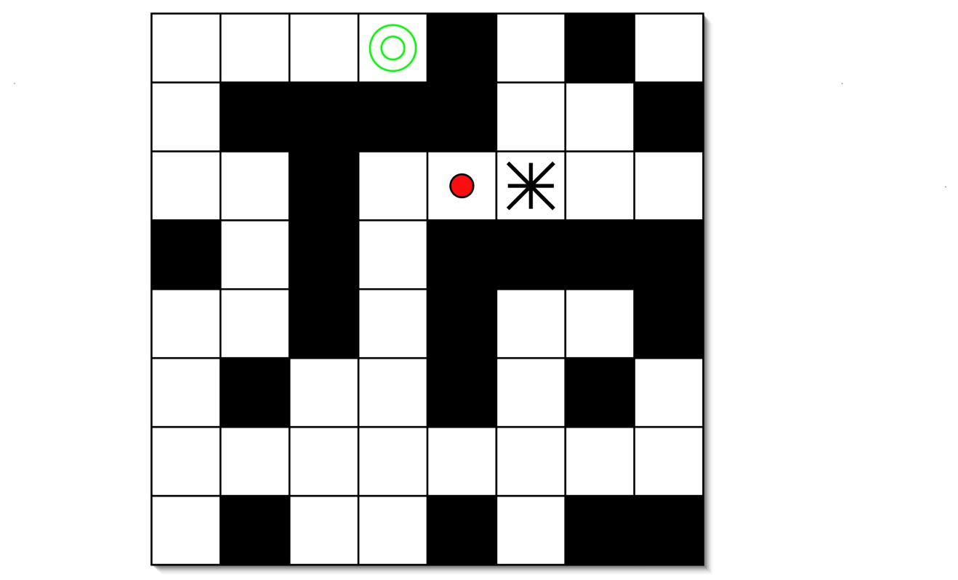
Where can Robo-rat go from here?
He has four choices for direction: north, south, east, and west.
Suppose Robo-rat chooses to go west.

Slide 4
Where does Robo-rat go now?
Does anything prevent him from going back east?
Clearly, he needs to mark the positions that he visits so he doesn’t visit them again.
But there were four directions he could have chosen at the first step; how can he get back to them?
Recursion is useful here
To search the maze, Robo-rat can recursively search each of the four directions.
If he is unsuccessful in one direction, eventually that recursive call will return.
The next recursive call is made and off Robo-rat goes again searching the next direction.
The backtracking that is needed is accomplished naturally by the recursion.

Slide 5
Recursive Design
Assume that there are primitive operations that allow you to:
mark the square Robo-rat is in,
check to see if a neighbor square is free to visit (not market and doesn’t have a wall)
move Robo-rat to a neighbor square,
At the end, Robo-rat should be in the same square as the battery (if a path to the battery exists).
Identify the problem
Identify the smaller problems
Identify how the answers are composed
Identify the base cases
Compose the recursive definition

Slide 6
Iterative Maze Search
Let’s convert recursion to iteration using an explicit stack.
Define the contents of the stack frame: the row and the column of the square to visit.
The general algorithm is as follows:
Put the first frame on the stack (starting positing)
While the stack is not empty
Take the top frame from the stack.
Do the computation indicated by the section.
If the computation is finished (reached the batter), place the returned value (True) in a variable *result*.
If a recursive call is needed (we will need four recursive calls (why?))
Put the current frame on the stack with the status set to indicate the state of the computation.
Put a start frame on the stack for the recursive call
Return *result*.
The iterative version does not need to keep a status. It just needs to keep the next location to check on a stack that is managed by us.
Anytime a square is placed on the stack as a potential direction, it will be marked as scheduled. Robo-rat will not visit a scheduled square until he finally takes it off of the stack.

